Slide 1


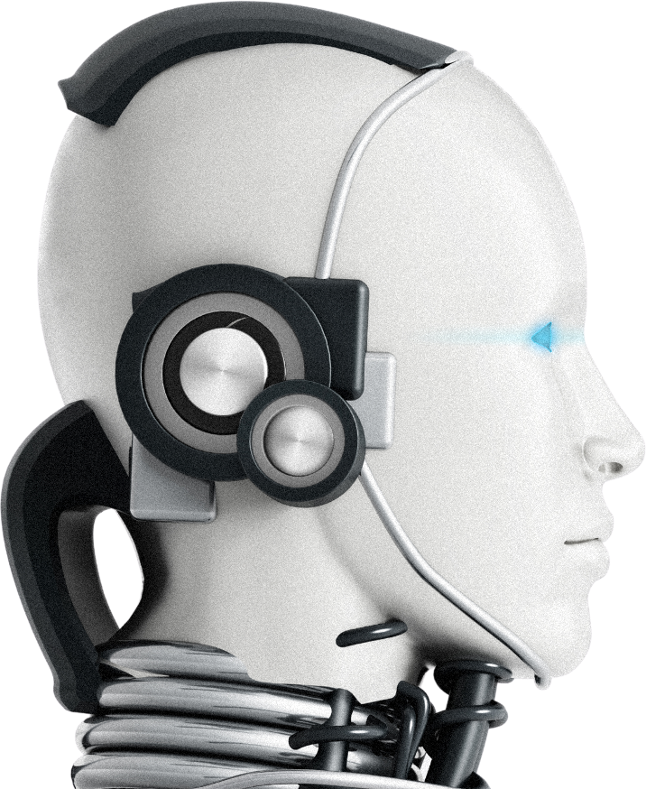
Campus-AI Hub
Revolutionizing Campus Life with AI
Smart Education | Mental Health | Campus Safety
Vision Coders
SANGEETA RANI RAI
PARITOSH SEN
RAGNI KUMARI

Slide 2
The Problem
As a college student we all face problems like
Difficulty in Finding Notes
Mental health issues
Lost belongings and difficult to find them
Hestitating in Sharing personal hobbies
And it's all because of the fear of being judged,gets shy or hesitate to share things

Slide 3
Solutions
AI Notes Generator
Answer Five simple Questions to receive guidance and solutions about your mental health issues
Anonymous report about anything and also get your lost things back
Share your personal interest like singing or dancing
Admin Dashboard

Slide 4
Thank You
FOR GIVING YOUR TIME AND ATTENTION
Notes:
[Smile warmly and make eye contact with the audience]
Thank you all so much for giving your time and attention today. It means a lot that you joined me for this important discussion.
[Pause briefly to let the message resonate]
I hope you found our conversation as meaningful and enlightening as I did. Remember, we’re all in this together, navigating challenges and supporting each other.
[Conclude with a friendly tone]
Feel free to reach out if you have any questions or thoughts. Let’s continue the conversation beyond today. Thank you once again!

